Slide 1
Text Mining analysis
Ponnappa Appanna MACHIMANDA
Uranie JEAN-LOUIS

Slide 2
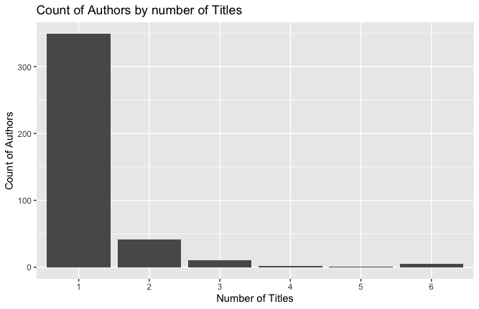
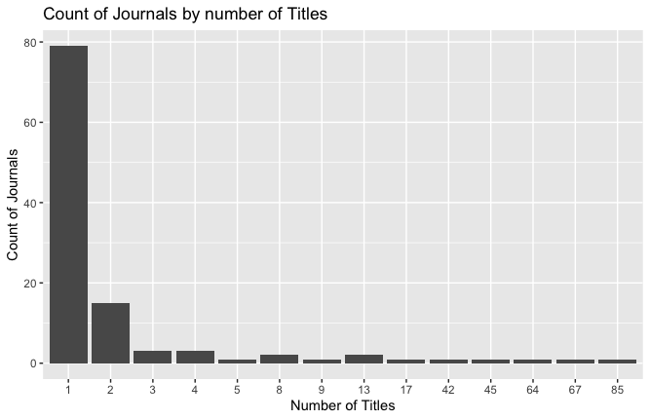
Overview Data:
Thare are a total of 7 columns and 506 rows of data. Each row represents a unique title and is given an ID number ranging from 1 to 506. Many titles can be published by the same journal and the same author can publish many titles.
409 unique authors. Most authors have published only 1 title. Maximum of 6 titles published by any 1 author.
The most prolific authors who have produced 6 titles each are: Bernatsky S, Brunner HI, Hanly JG, Petri M, and Yee CS.
112 unique journals. Most journals contain only 1 title. Maximum of 85 titles by a journal “Arthritis and rheumtism” which were written by 70 authors.

Slide 3
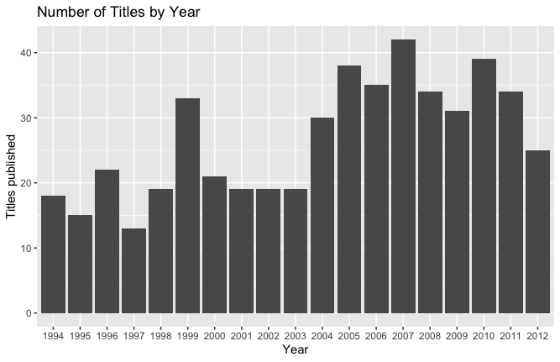
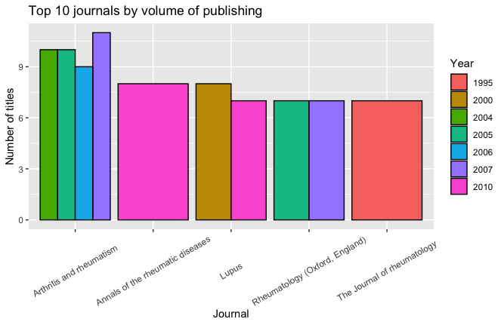
Overview Data (cont):
Maximum number of titles were published in the year 2007.
There are totally 19 years of data.
2004 marks a sharp increase in the volume of titles published. There seems to be 2 significant year ranges by average volume of titles, which are 1994-2003 and 2004 to 2012.
“Arthritis and rheumatism” journal consistently published the most titles from 2004 to 2007 which may have contributed most to the increased volume of titles.

Slide 4
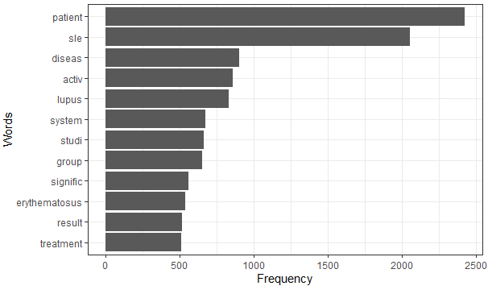
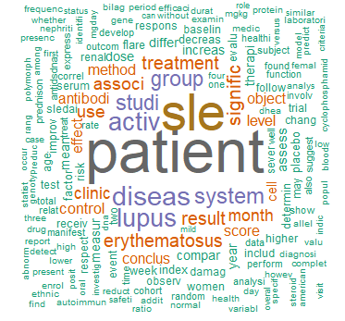
Word’s frequency

Slide 5
Non agregated data

Slide 6

Chi square test
Strong association between words and papers
Words frequency are significantly différents from each other
Words frequency are significantly different from each papers

Slide 7
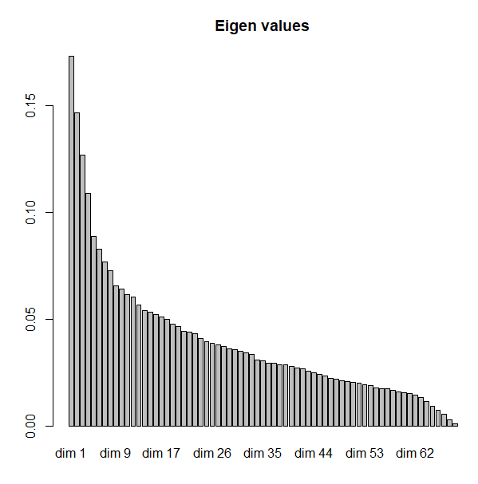
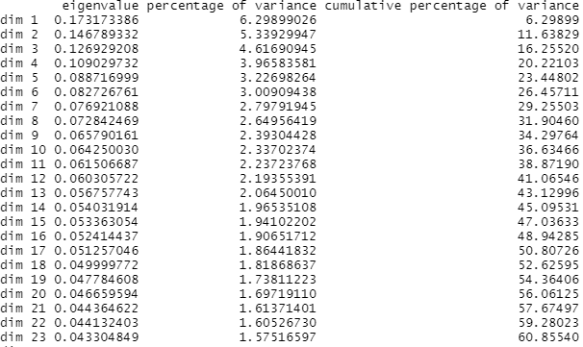
Eigen values

Slide 8
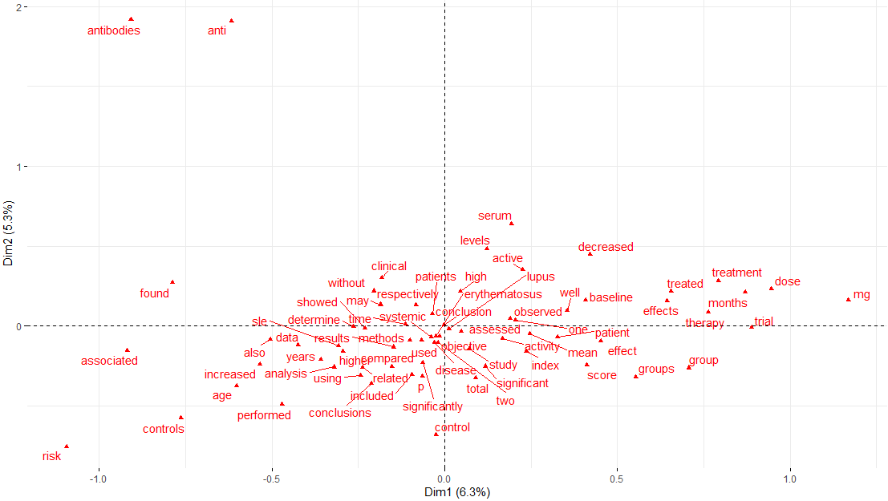
CA with non agregated data

Slide 9
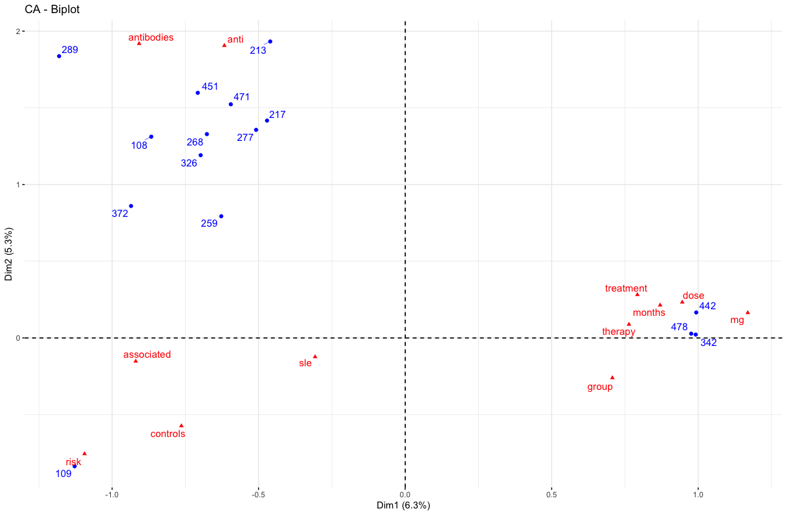
Identifying more precise topics
The dimension 1 and 2 explain 11.6% of the variance and there are 12 words which significantly contribute to these 2 axes.
For the articles, there is a dip in contribution to the axes after the top 7. But there are many articles which remain significant. Here we have plotted the top 15.
Dimension 1 seperates research topics involving “treatment methodology” indicated by words like : treatment, therapy,dose,months,mg, group. These are best characterised by articles ID 478, 442,342.
However the top contributing articles appear on the other side away from the treatment based articles. These are characterised by words which “describe the disease” like: antibodies, anti, associated, controls, risk, and sle.

Slide 10
agregated data

Slide 11

Chi square test
Strong association between words and years
Words frequency are significantly différents from each other
Words frequency are significantly different from each years

Slide 12
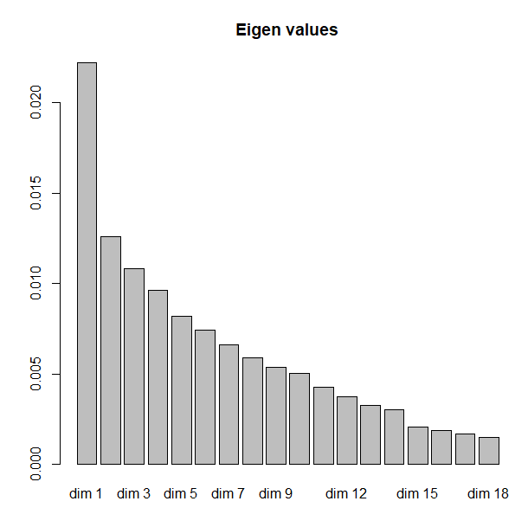
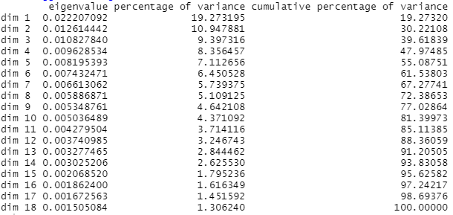
Eigen values

Slide 13
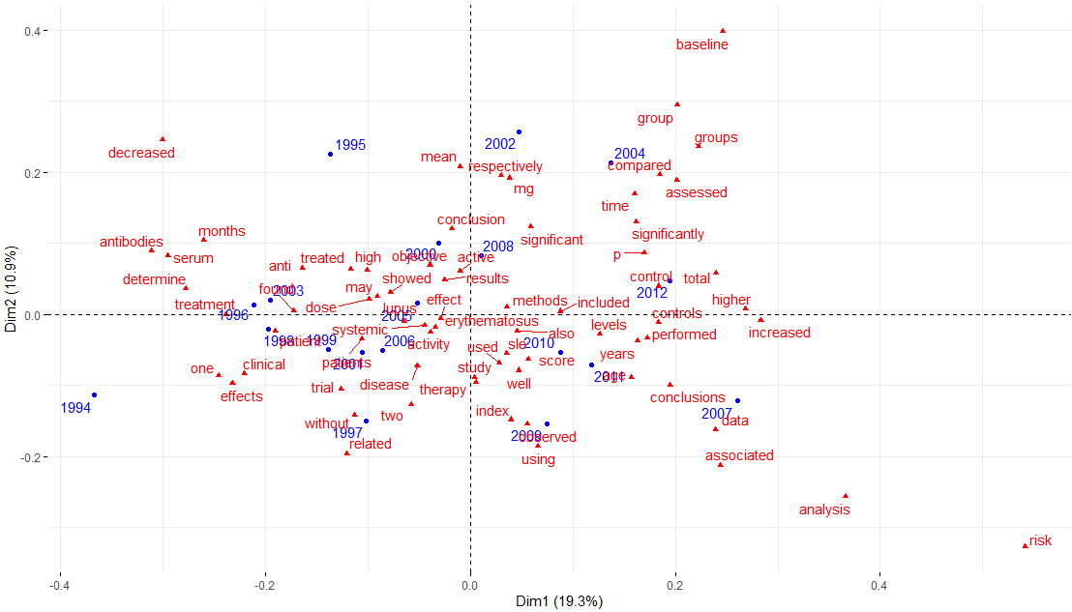
CA agregated by year
Notes:
1994,1995,1996 -> antibodies, determine, treatment ; Balance of fewer articles describing both the disease and treatment methodlogies.
1997,1998,1999 -> clinical, trial, effects, patient ; Emergence of more clinical trials articles.
2000,2001,2002 -> systemic, may, dose, showed, objective, results, mg, mean. Articels with more emperical measures used to determine dosage of drugs.
2003,2004,2005 -> found, anti, treated, compared,group, assessed, lupus,effect . Studies on drug effects, statistical comparison of groups, effects of time.
2006,2007,2008 -> activity, disease, systemic, conclusions, data, significant, conclusion. Some longterm studies have been concluded with data. Possibly of drug clinical trials.
2009,2010,2011,2012 -> observed, using, sle,score, used, age, control, total, performed. Monitoring of drug use. Mostly after approval of trials and release into market.

Slide 14
Evolution of research
1994,1995,1996 -> antibodies, determine, treatment. Balance of fewer articles describing both the disease and treatment methodlogies.
1997,1998,1999 -> clinical, trial, effects, patient. Emergence of more clinical trials articles.
2000,2001,2002 -> systemic, may, dose, showed, objective, results, mg, mean. Articles with more emperical measures used to determine dosage of drugs.
2003,2004,2005 -> found, anti, treated, compared,group, assessed, lupus,effect. Studies on drug effects, statistical comparison of groups, effects of time.
2006,2007,2008 -> activity, disease, systemic, conclusions, data, significant, conclusion. Some longterm studies have been concluded with data. Possibly of drug clinical trials.
2009,2010,2011,2012 -> observed, using, sle,score, used, age, control, total, performed. Monitoring of drug use. Mostly after approval of trials and release into market.
Notes:
1994,1995,1996 -> antibodies, determine, treatment ; Balance of fewer articles describing both the disease and treatment methodlogies.
1997,1998,1999 -> clinical, trial, effects, patient ; Emergence of more clinical trials articles.
2000,2001,2002 -> systemic, may, dose, showed, objective, results, mg, mean. Articels with more emperical measures used to determine dosage of drugs.
2003,2004,2005 -> found, anti, treated, compared,group, assessed, lupus,effect . Studies on drug effects, statistical comparison of groups, effects of time.
2006,2007,2008 -> activity, disease, systemic, conclusions, data, significant, conclusion. Some longterm studies have been concluded with data. Possibly of drug clinical trials.
2009,2010,2011,2012 -> observed, using, sle,score, used, age, control, total, performed. Monitoring of drug use. Mostly after approval of trials and release into market.

Slide 15
Evolution of drugs agregated data

Slide 16

Chi square test
Week association between drugs and years
Drugs frequency are not significantly différents from each other
Drugs frequency are not significantly different from each years

Slide 17
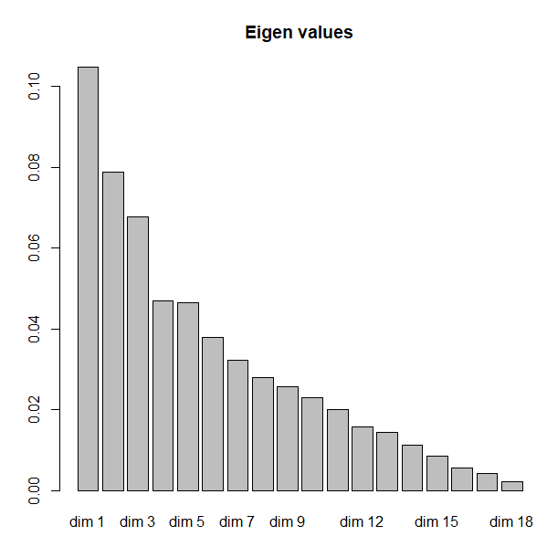
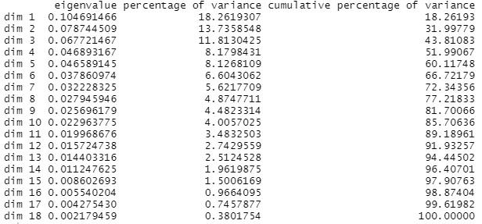
Eigen values

Slide 18
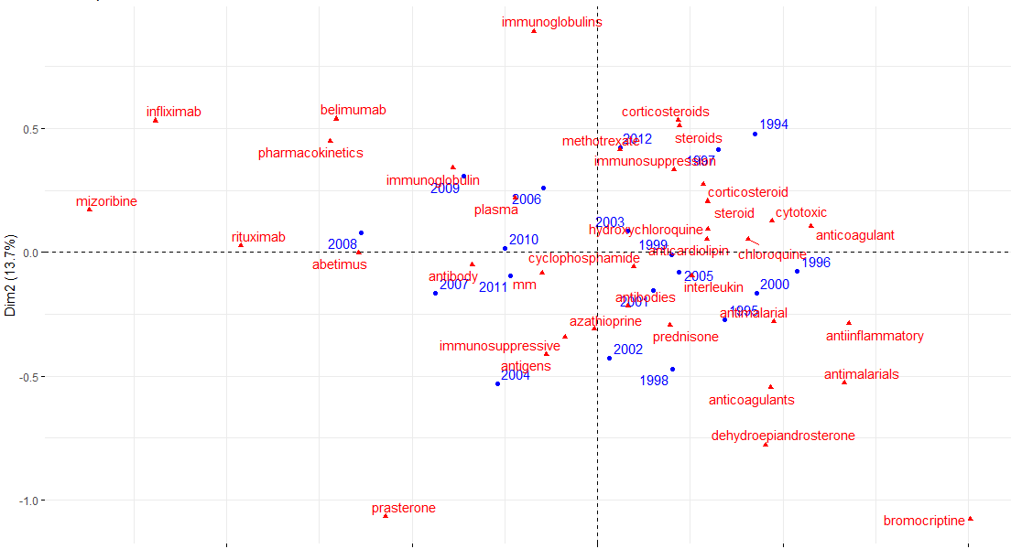
CA evolution of drugs agregated by year
Notes:
1994,1995,1996 - > steroids, corticosteroids,antimalarial, anticoagulant
1997,1998,1999 - > immunosuppression, anticoagulant, cyclophosphamide (low representation), hydroxychoroquinone
2000, 2001, 2002 - > antiinflammatory, antibodies (low representation), azathioprine
2003, 2004, 2005 - > hydroxychoroquinone, antigns, immunosuppresive, interleukin
2006, 2007, 2008 - > plasma (low representation), antibody, abetimus, rituximab, mizoribine, infliximab, pharmacokinetics, belimumab
2009, 2010, 2011, 2012 - > immunoglobulin, cyclophosphamide, mm (low representation) , methotrexate, immunoglobulins

Slide 19
evolution of drugs agregated
1994,1995,1996 -> steroids, corticosteroids,antimalarial, anticoagulant
1997,1998,1999 -> immunosuppression, anticoagulant, cyclophosphamide (low representation), , hydroxychoroquinone
2000, 2001, 2002 -> antiinflammatory, antibodies (low representation), azathioprine
2003, 2004, 2005 -> hydroxychoroquinone, antigns, immunosuppresive, interleukin
2006, 2007, 2008 -> plasma (low representation), , antibody, abetimus, rituximab, mizoribine, infliximab, pharmacokinetics, belimumab
2009, 2010, 2011, 2012 -> immunoglobulin, cyclophosphamide, mm (low representation), methotrexate, immunoglobulins

Slide 20
Thank you for listening

